Slide 1

Introduction to Servlet
Dept. of B. Voc.(Software Development and System Administration)
St. Joseph’s College(Autonomous)
Trichy-02
By
Dr. J. Ronald Martin

Slide 2
Servlet
Servlet is a java program that runs inside JVM on the web server.
It is used for developing dynamic web applications.

Slide 3
Life Cycle of Servlet
Servlet life cycle contains five steps:
Loading of Servlet
Creating instance of Servlet
Invoke init() once
Invoke service() repeatedly for each client request
Invoke destroy()

Slide 4
Step 1: Loading of Servlet
When the web server (e.g. Apache Tomcat) starts up, the servlet container deploy and loads all the servlets.
Step 2: Creating instance of Servlet
Once all the Servlet classes loaded, the servlet container creates instances of each servlet class. Servlet container creates only once instance per servlet class and all the requests to the servlet are executed on the same servlet instance.
Step 3: Invoke init() method
Once all the servlet classes are instantiated, the init() method is invoked for each instantiated servlet.

Slide 5
Step 4: Invoke service() method
Each time the web server receives a request for servlet, it spawns a new thread that calls service() method.
If the servlet is GenericServlet then the request is served by the service() method itself,
if the servlet is HttpServlet then service() method receives the request and dispatches it to the correct handler method based on the type of request.
Step 5: Invoke destroy() method
When servlet container shuts down(this usually happens when we stop the web server), it unloads all the servlets and calls destroy() method for each initialized servlets.

Slide 6
Architecture Diagram:
The following figure depicts a typical servlet life-cycle scenario.
  First the HTTP requests coming to the server are delegated to the servlet container.
  The servlet container loads the servlet before invoking the service() method.
  Then the servlet container handles multiple requests by spawning multiple threads, each thread executing the service() method of a single instance of the servlet.

Slide 7
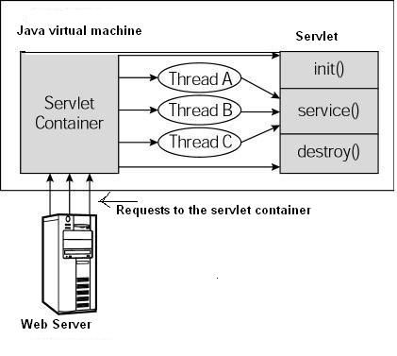

Slide 8
How Servlet Works?
When the web server (e.g. Apache Tomcat) starts up, the servlet container deploy and loads all the servlets.
Once the servlet is loaded, the servlet container creates the instance of servlet class. For each instantiated servlet, its init() method is invoked.
Client (user browser) sends an Http request to web server on a certain port. Each time the web server receives a request, the servlet container creates HttpServletRequest and HttpServletResponse objects. The HttpServletRequest object provides the access to the request information and the HttpServletResponse object allows us to format and change the http response before sending it to the client.
When servlet container shuts down, it unloads all the servlets and calls destroy() method for each initialized servlets.

Slide 9
import javax.servlet.http.*;
import javax.servlet.*;
import java.io.*;
public class DemoServlet extends HttpServlet{
public void doGet(HttpServletRequest req,HttpServletResponse res)
throws ServletException,IOException
{
res.setContentType("text/html");//setting the content type
PrintWriter pw=res.getWriter();//get the stream to write the data
//writing html in the stream
pw.println("<html><body>");
pw.println("Welcome to servlet");
pw.println("</body></html>");
pw.close();//closing the stream
}
}

